Slide 1




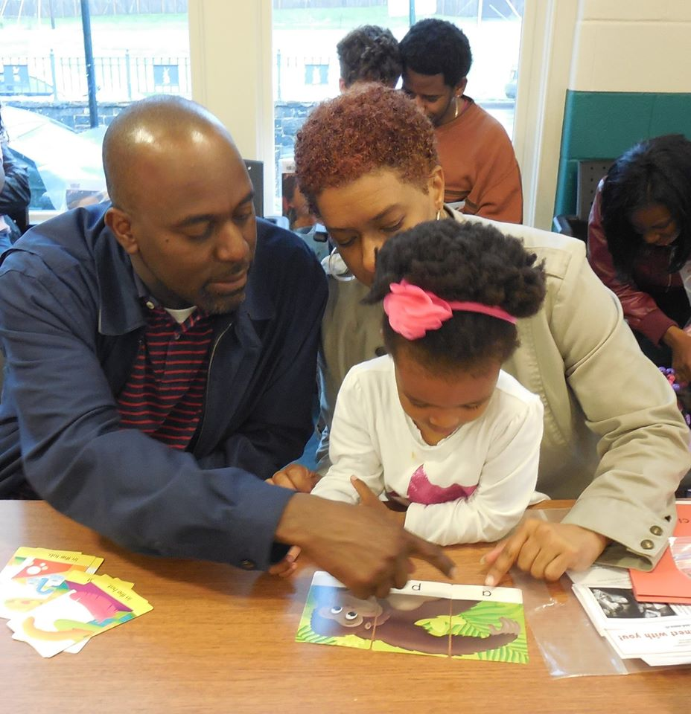

Excellence in Children’s Early Language and Literacy

Slide 2










Funders and Partners

Slide 3
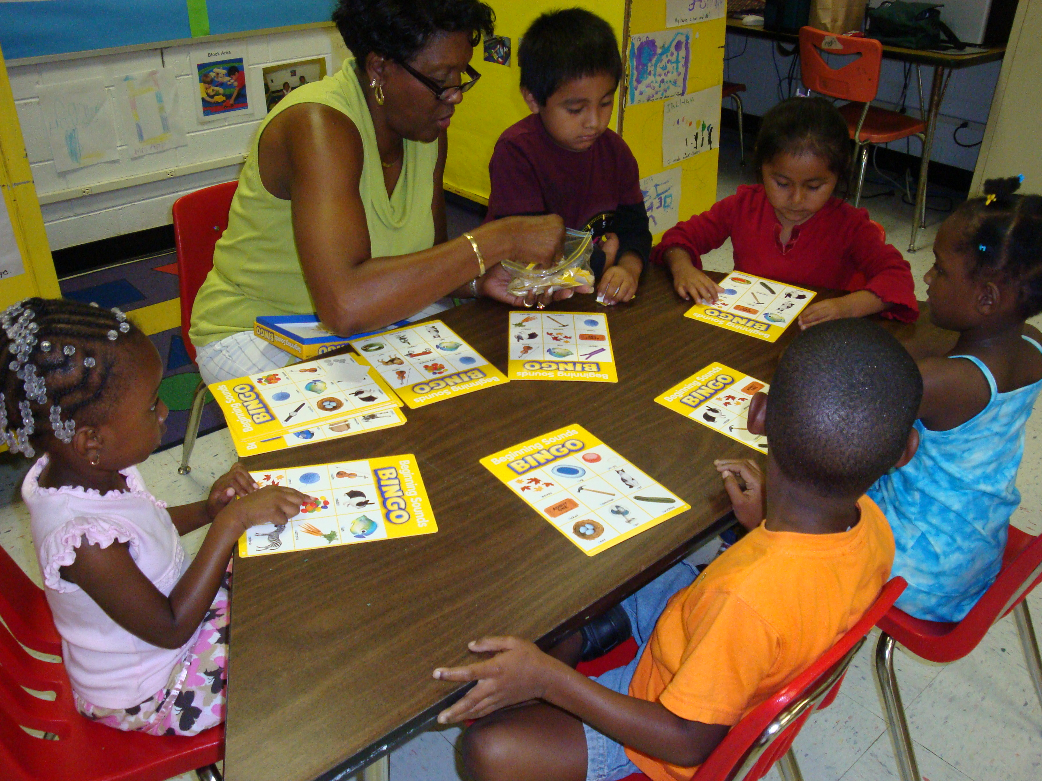
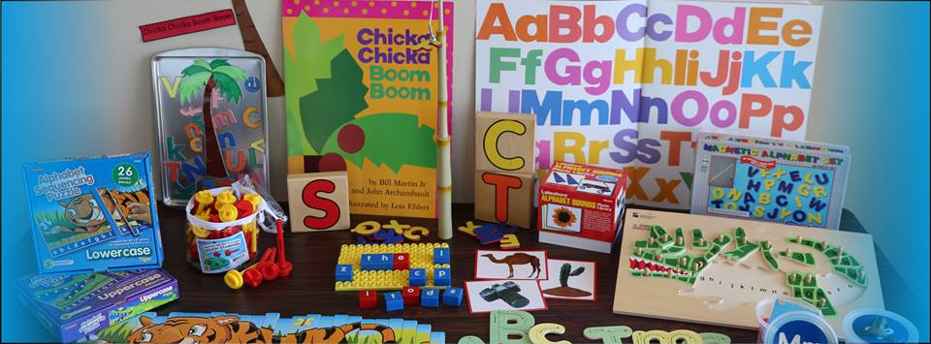
Mission Statement
ExCELL brings together families, communities, and early childhood educators to ensure that children receive enriched and coordinated learning opportunities to support the development of the early language and literacy skills that are predictive of reading success.

Slide 4
Diverse Sites
State Level
Local Level
Eastern Region – VPI/Head Start
  Petersburg
  Hopewell
  Williamsburg
Northern Virginia – NVFS Head Start
  Arlington, Manassas, Oakton, Woodbridge, Loudoun
Central Region – VPI/Head Start
  Lynchburg City
  Campbell County
  Amherst County
  Bedford County
Richmond City
  Richmond Public Schools
    Regional preschool Centers
    VPI/Head Start/ECSE
    Kindergarten and First Grades
  Community-based childcare centers

Slide 5
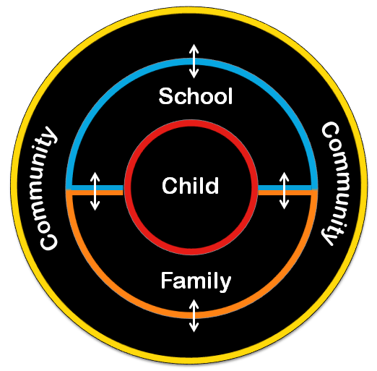
Conceptual Model
Notes:
Comprehensive model
CINDY
Goal: Early childhood educators will provide literacy-rich classroom environments and incorporate research-based language and literacy instructional approaches into their teaching practices
Accomplished through:
1 - PD and coaching - Systematic and ongoing, research based content and approaches, focuses on instruction, quality of interactions, engaging and supporting families
(SEE ExCELL Plan Document for PD topics throughout the year)
-Coaching – unique feature of program, videotaping and reflection, co-teaching, co-planning, modeling, classroom arrangement and effective use of materials emphasized
-Both linked to ongoing assessments (child and classroom level)
2 - Instructional materials/children’s books – classrooms receive high quality literacy materials organized for daily use in large/small group, teacher-guided, or child-initiated activities.
-Materials are linked to key literacy skills w/ hands on focus
-Children’s library provided for each classroom – linked to implemented curriculum
CINDY
Goal: Families will be engaged and involved in their children’s learning at home, in the community, and in the classroom and will have the knowledge and tools to provide an improved home literacy environment that supports acquisition of early literacy skills.
Accomplished through:
1 – Events – Classroom/school based, Interactive sessions (parents separate from children) , hands on focus where families learn about and practice strategies to use at home to reinforce EL learning at school
-Linked to PD content (SEE ExCELL Plan)
2 - Directly connects families to the classroom learning activities– see and participate in classroom activity led by teacher on targeted topic
3 – Book bag program – RaR – rotation book bag program, more access to high quality children’s books to families, connected to curriculum, linked to local libraries (Blue bags/hosting blue bag events, tracking library use, incentives)
4 – Home literacy materials – provided each month, link to PD/family event topics, linked to classroom learning
Take home books – linked to curriculum and include supportive guides for family-focused activities that extend learning and enhance book reading
Goal: Families will be engaged and involved in their chlidren’s learning at home, in the community, and in the classroom and will have the knowledge and tools to provide an improved home literacy environment that supports acquisition of early literacy skills.
Goal: Local community resources need to be aware of ExCELL and the importance of school readiness in general and early litearcy in particular, and need to be accessible and able to effectively support children’s language and literacy development.
Needs to be sustainable partnerships
Accomplish through:
2 - Partnering w/ community organizations – emphasize strong partnership w/ RPL- local libraries and library staff
– Partner for PD and family events, holding PD and family events jointly in community venues – libraries, museums, parks
-Blue bags and related blue bag events
-Utilize volunteer groups - included in many events and activities
-Last but not least – extending program to community based childcare centers/programs (FRIENDS, YMCA)
Coordinate efforts across community initiatives and programs
1 - Connecting families to local resources - Talking with and about other services and organizations in the community (PFFN helps here), advertising, guests coming to events (adult literacy, parent education, local library etc.)
Idea of home visitors being trained by us – getting PD from us; idea of training local librarians and adult literacy programs that encourage early literacy component
Goal: Local community resources need to be aware of ExCELL and the importance of school readiness in general and early litearcy in particular, and need to be accessible and able to effectively support children’s language and literacy development.
Accomplish through:
2 - Partnering w/ community organizations – emphasize strong partnership w/ RPL- local libraries and library staff
– Partner for PD and family events, holding PD and family events jointly in community venues – libraries, museums, parks
-Blue bags and related blue bag events
-Utilize volunteer groups - included in many events and activities
-Last but not least – extending program to community based childcare centers/programs (FRIENDS, YMCA)

Slide 6
Classroom Materials
Preschool
Infant/Toddler

Slide 7
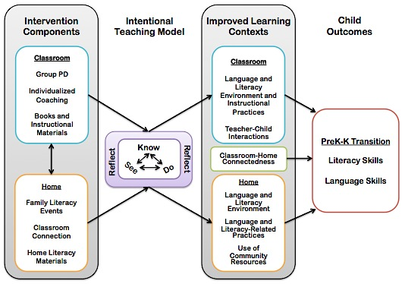
Theory of Change
Notes:
Evaluation includes measures targeting each of the “improved learning environments” so we can assess the degree to which ExCELL program is impacting these proximal outcomes
Evaluation also include measures of children’s LL skills as more distal outcomes influenced by the proximal outcomes (learning environments).
The Intentional Teaching Model (ITM; Hamre, Downer, Jamil, & Pianta, 2012) informs our theory of change by articulating a powerful adult learning process that results in changes to teacher practice. The ITM suggests that PD interventions should target knowledge building about new practices (KNOW), provide opportunities to see these practices in authentic settings (SEE) and offer opportunities for using these new practices in their particular setting (DO). Finally, the model stresses the importance of structured opportunities to analyze the application of practices and plan for change (REFLECT).

Slide 8
ExCELL Evaluation Questions
To what extent do project activities and services result in an improvement in the quality of:
  Teacher-child interactions
  Classroom language and literacy environments
  Teacher application of research-based theory and instruction
To what extent do project activities and services result in an improvement in the quality of:
  Home language and literacy environments
  Literacy-related beliefs and attitudes
  Use of community resources
To what extent do project activities and services result in an improvement in outcomes for children’s early language and literacy skills?
Notes:
To what extent do the classrooms and teachers exhibit excellence?

Slide 9
Summary of Results
Significant gains were demonstrated on teacher/classroom quality measures of environment, interactions, and instruction across multiple years.
Significant improvements in the home literacy environment and use of community resources were demonstrated on parent survey measures.
Children demonstrated significant increases on all standardized measures of early language and literacy skills with at least 90% of children meeting benchmarks.
Notes:
Enhanced home literacy environments/literacy-related practices
Significant increase in number of children’s books at home
Significant increase in frequency of story-telling by family members
Significant decrease in number of hours per day watching TV
Significant increase in frequency of shared storybook reading with reported improvements in:
Parent asking child questions about story
Child’s level of attention/engagement
Child’s level of enjoyment
Child “reading” the book, telling the story
Improved use of community resources
Significant increase in frequency of library visits with increases in:
Browsing and playing in children’s section
Getting advice from librarians about children’s books
Checking out children’s materials (books, videos, etc.) to take home
Statistically significant increases on standardized assessments of early language and literacy skills
95-100% of children met developmental benchmarks in key predictors of later reading achievement – all project years
Letter knowledge
Name writing
Rhyme

Slide 10
